Slide 2
Objectives Overview
Define system software and identify the two types of system software
Describe the functions of an operating system
Summarize the startup process on a personal computer
Summarize the features of several stand-alone operating systems
Briefly describe various server operating systems
Summarize the features of several embedded operating systems
Explain the purpose of several utility programs
See Page 397
for Detailed Objectives

Slide 3
System Software
System software consists of the programs that control or maintain the operations of the computer and its devices
Operating systems
Utility Programs
Page 398

Slide 4
Operating Systems
An operating system (OS) is a set of programs containing instructions that work together to coordinate all the activities among computer hardware resources
Start and shut down a computer
Provide a user interface
Manage programs
Manage memory
Coordinate tasks
Configure devices
Establish an Internet connection
Monitor performance
Provide utilities
Automatically update
Control a network
Administer security
Pages 398 - 399

Slide 5
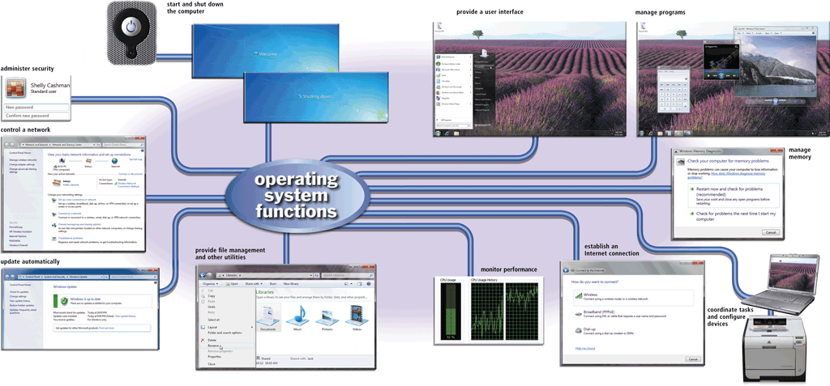
Operating Systems
Pages 398 – 399
Figure 8-1

Slide 6
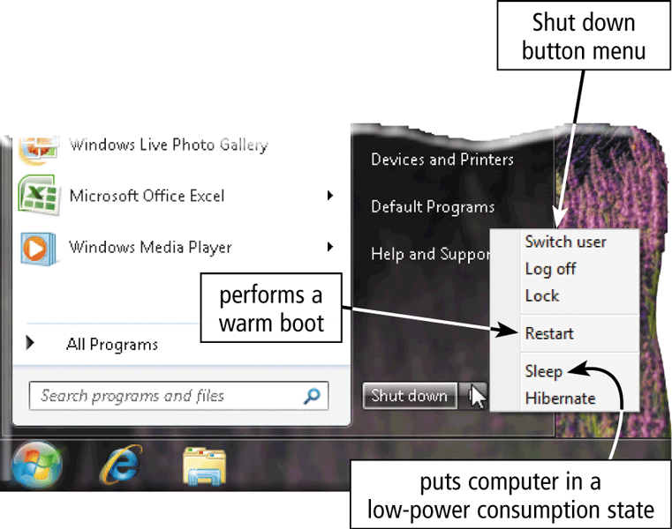
Operating System Functions
The process of starting or restarting a computer is called booting
Cold boot
Turning on a computer that has been powered off completely
Warm boot
Using the operating system to restart a computer
Page 400
Figure 8-2

Slide 7
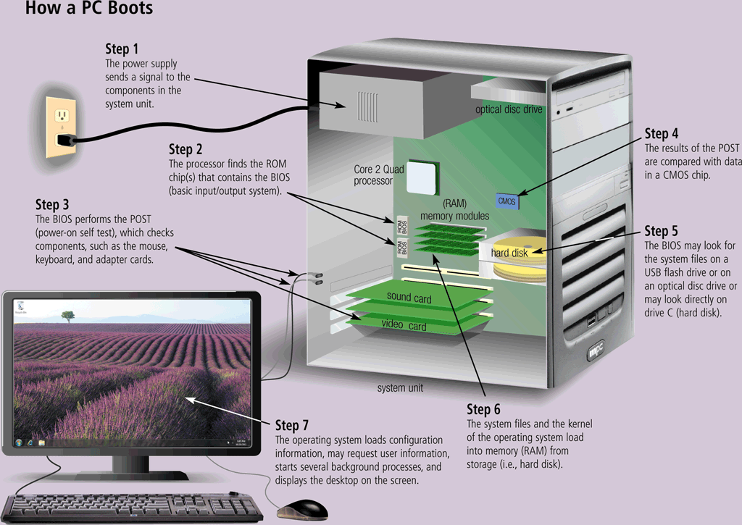
Operating System Functions
Page 401
Figure 8-3

Slide 8
Operating System Functions
A boot drive is the drive from which your computer starts
You can boot from a boot disk
A recovery disk contains a few system files that will start the computer
Page 402

Slide 9
Operating System Functions
An operating system includes various shut down options
Sleep mode saves any open documents and programs to RAM, turns off all unneeded functions, and then places the computer in a low-power state
Hibernate saves any open documents and programs to a hard disk before removing power from the computer
Page 402

Slide 10
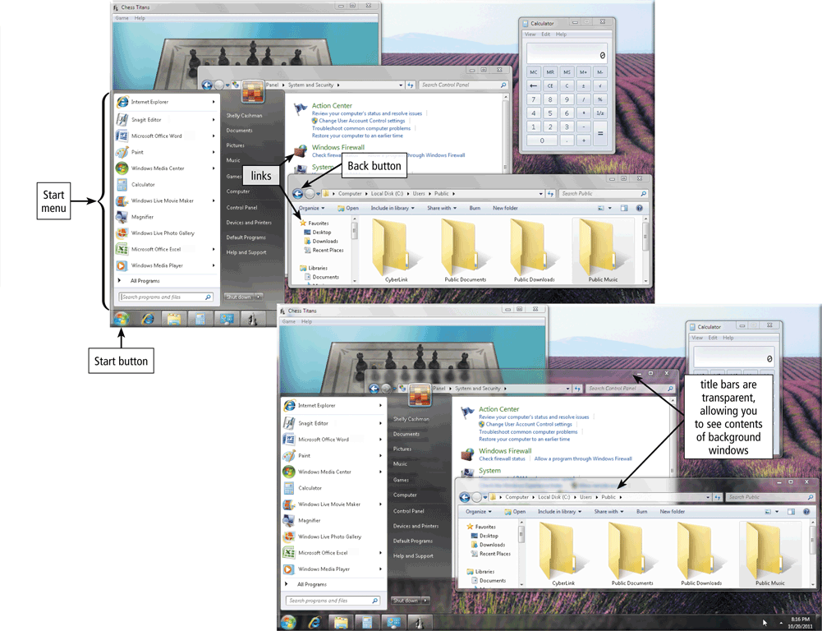
Operating System Functions
A user interface controls how you enter data and instructions and how information is displayed on the screen
With a graphical user interface (GUI), you interact with menus and visual images
Pages 402 – 403
Figure 8-4

Slide 11
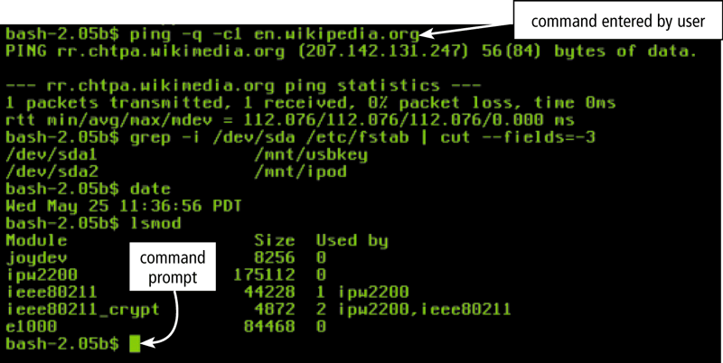
Operating System Functions
With a command-line interface, a user uses the keyboard to enter data and instructions
Page 403
Figure 8-5

Slide 12
Operating System Functions
How an operating system handles programs directly affects your productivity
Single user and multiuser
Single tasking and multitasking
Foreground and background
Preemptive multitasking
Multiprocessing
Pages 404 - 405

Slide 13
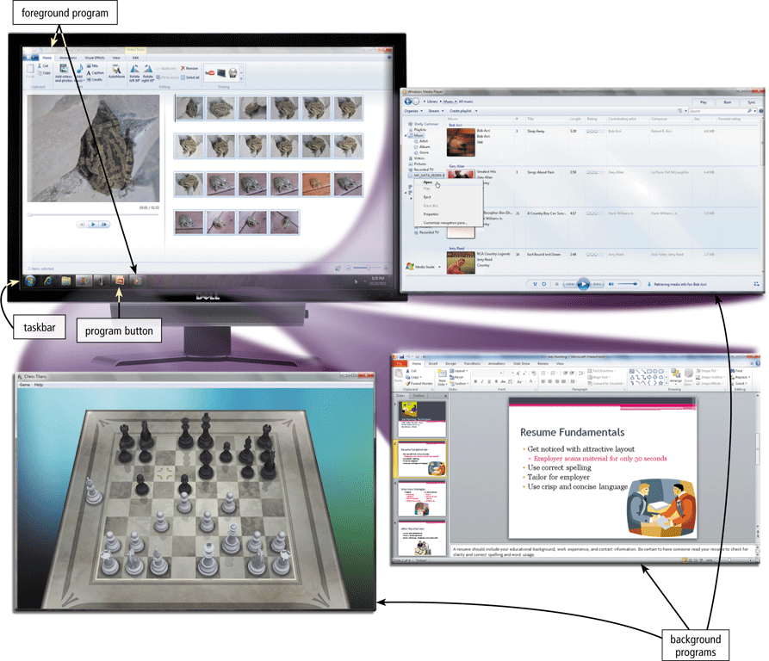
Operating System Functions
Page 404
Figure 8-6

Slide 14
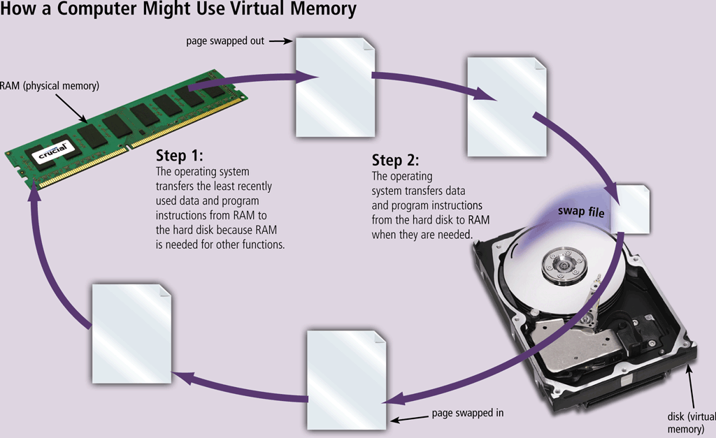
Operating System Functions
Memory management optimizes the use of RAM
Virtual memory is a portion of a storage medium functioning as additional RAM
Page 406
Figure 8-8

Slide 15
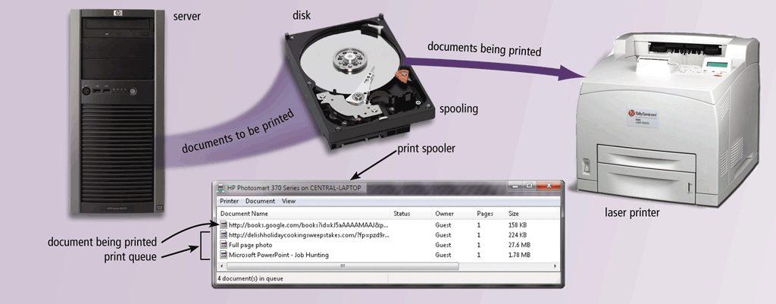
Operating System Functions
The operating system determines the order in which tasks are processed
Page 407
Figure 8-9

Slide 16
Operating System Functions
A driver is a small program that tells the operating system how to communicate with a specific device
Plug and Play automatically configures new devices as you install them
Page 408

Slide 17
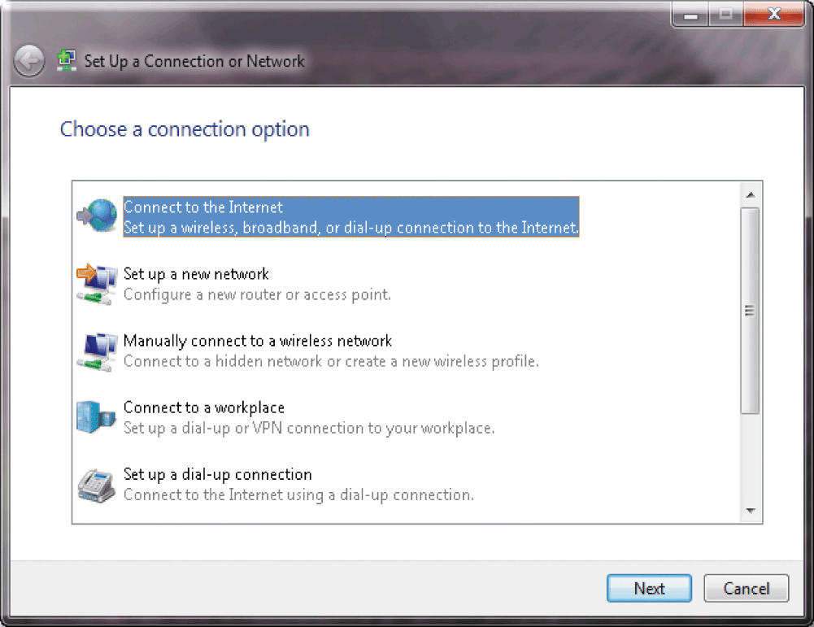
Operating System Functions
Operating systems typically provide a means to establish Internet connections
Page 408
Figure 8-10

Slide 18
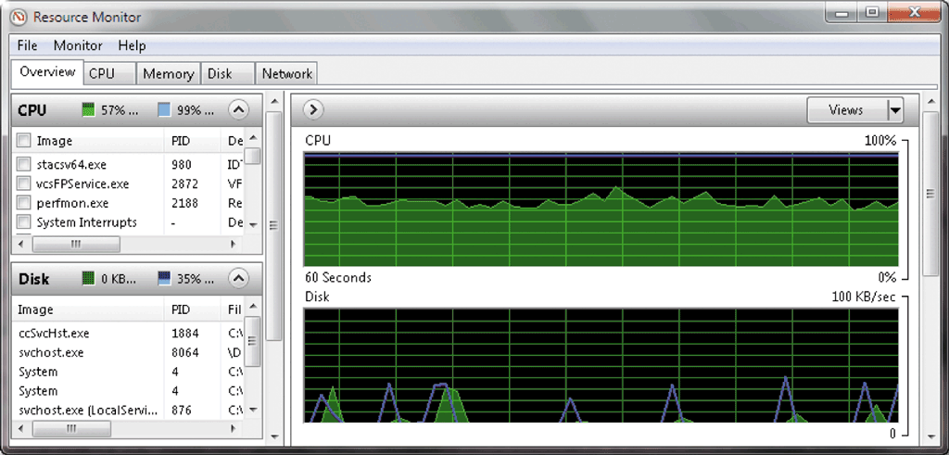
Operating System Functions
A performance monitor is a program that assesses and reports information about various computer resources and devices
Pages 408 – 409
Figure 8-11

Slide 19
Operating System Functions
Operating systems often provide users with the capability of:
Managing files
Searching for files
Viewing images
Securing a computer
Uninstalling programs
Cleaning up disks
Defragmenting disks
Diagnosing problems
Backing up files and disks
Setting up screen savers
Page 409

Slide 20
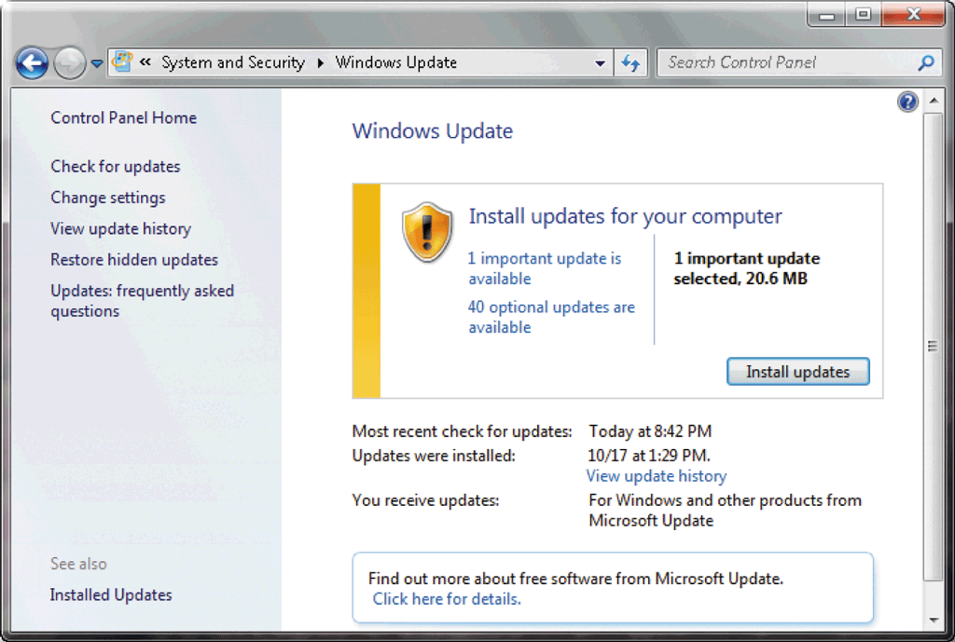
Operating System Functions
Automatic update automatically provides updates to the program
Page 409
Figure 8-12

Slide 21
Operating System Functions
Some operating systems are designed to work with a server on a network
A server operating system organizes and coordinates how multiple users access and share resources on a network
A network administrator uses the server operating system to:
Add and remove users, computers, and other devices
Install software and administer network security
Page 410

Slide 22
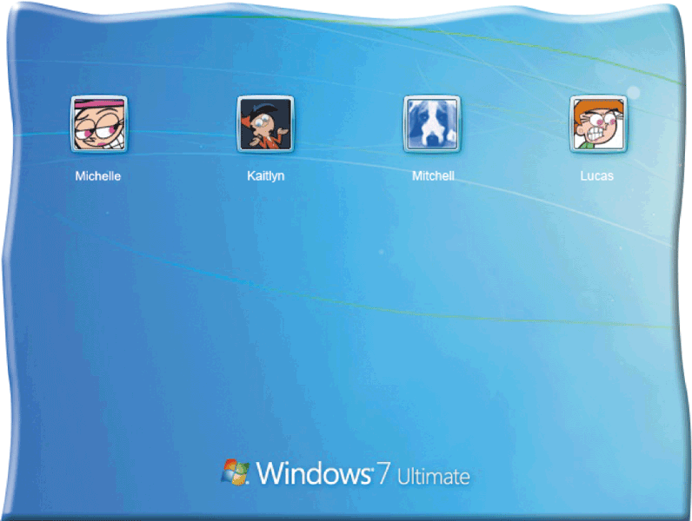
Operating System Functions
Each user has a user account
A user name, or user ID, identifies a specific user
A password is a private combination of characters associated with the user name
Page 410
Figure 8-13

Slide 23
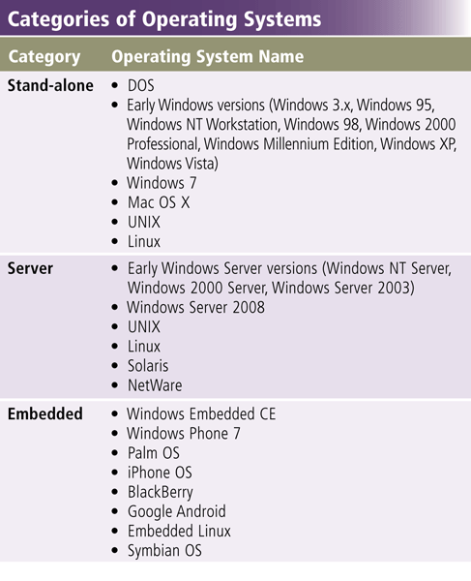
Types of Operating Systems
Page 412
Figure 8-14

Slide 24
Stand-Alone Operating Systems
A stand-alone operating system is a complete operating system that works on a desktop computer, notebook computer, or mobile computing device
Windows 7
Mac OS X
UNIX
Linux
Page 412

Slide 25
Stand-Alone Operating Systems
Windows 7 is Microsoft’s fastest, most efficient operating system to date and is available in multiple editions:
Windows 7 Starter
Windows 7 Home Premium
Windows 7 Ultimate
Windows 7 Professional
Pages 413 - 414

Slide 26
Stand-Alone Operating Systems
Windows 7 provides programs such as:
Windows Firewall
Windows Media Player
Desktop Gadget Gallery
Windows DVD Maker
Page 414

Slide 27
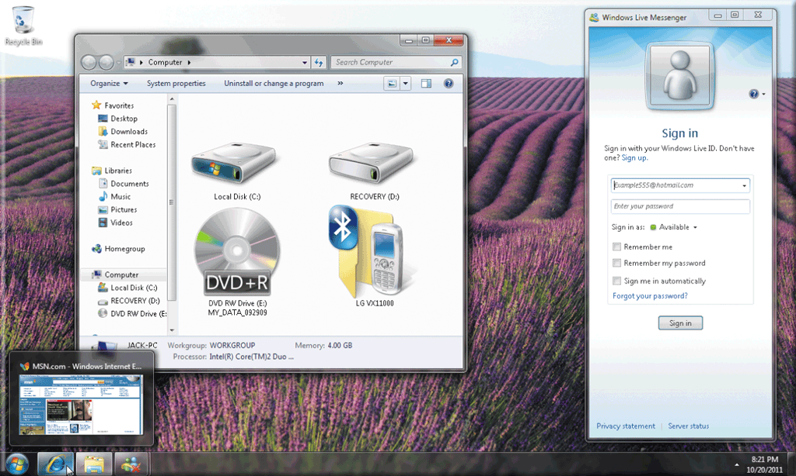
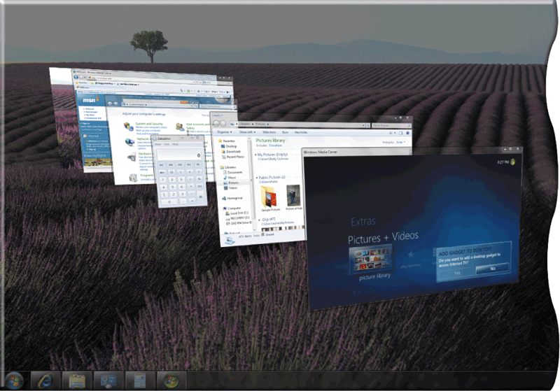
Stand-Alone Operating Systems
Page 414
Figures 8-16 – 8-17

Slide 28
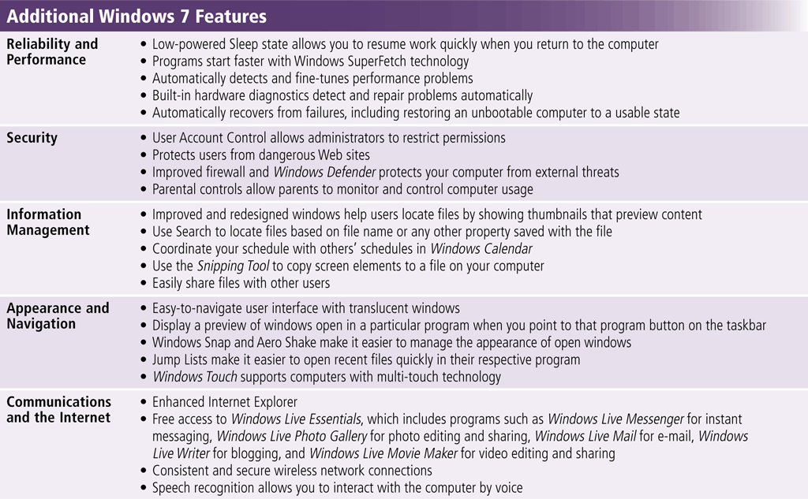
Stand-Alone Operating Systems
Page 415
Figure 8-18

Slide 29
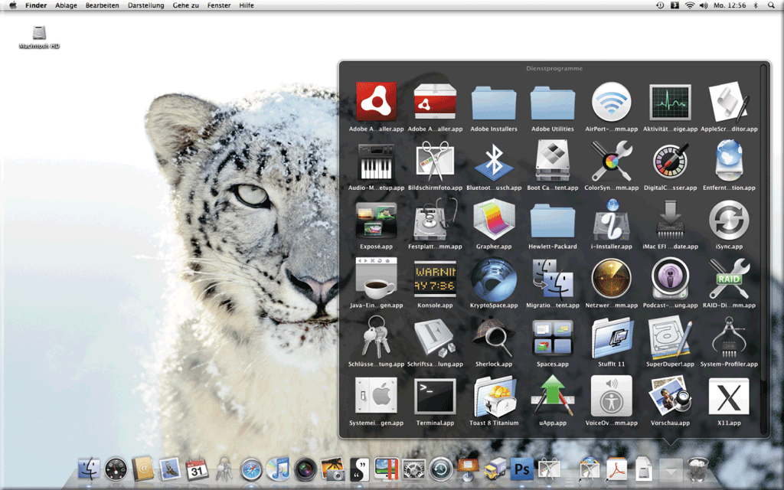
Stand-Alone Operating Systems
The Macintosh operating system has set the standard for operating system ease of use
Latest version is Mac OS X
Page 415
Figure 8-19

Slide 30
Stand-Alone Operating Systems
UNIX is a multitasking operating system developed in the early 1970s
Linux is an open-source, popular, multitasking UNIX-type operating system
Pages 416 – 417
Figures 8-20 – 8-21

Slide 31
Server Operating Systems
Windows Server 2008
UNIX
Linux
Solaris
NetWare
Pages 417 - 418

Slide 32
Server Operating Systems
Windows Server 2008 is an upgrade to Windows Server 2003
Part of the Windows Server 2008 family
Multiple editions
Most editions include Hyper-V, a virtualization technology
Virtualization is the practice of sharing or pooling computing resources
Pages 417 - 418

Slide 33
Embedded Operating Systems
An embedded operating system resides on a ROM chip on a mobile device or consumer electronic device
Windows Embedded CE
Windows Phone 7
Palm OS
iPhone OS
BlackBerry
Embedded Linux
Symbian OS
Google Android
Pages 418 - 420

Slide 34
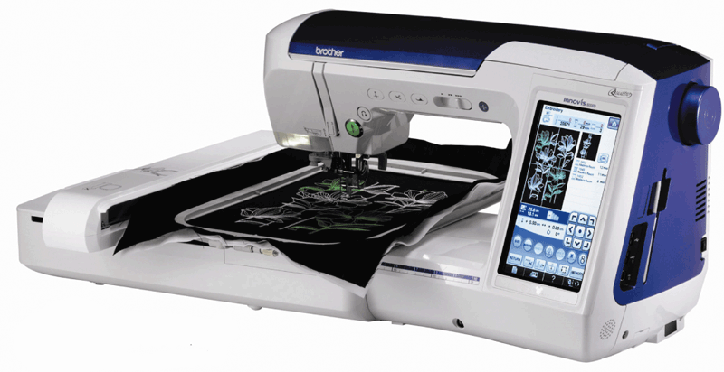
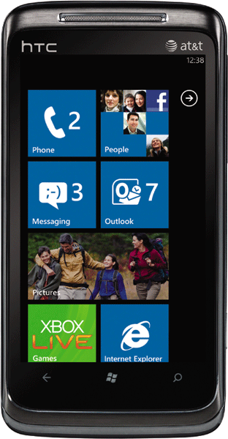
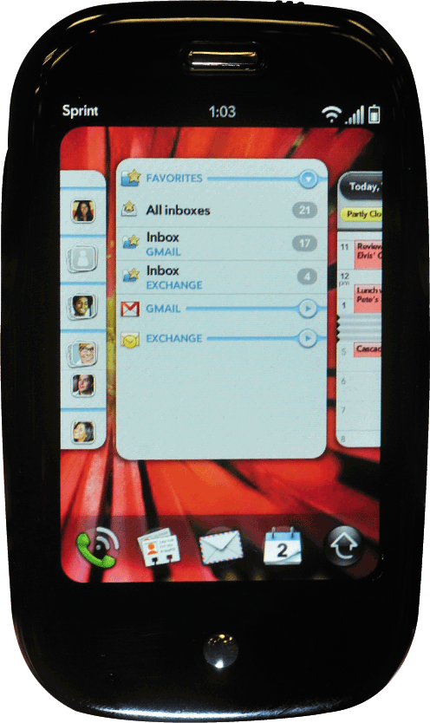
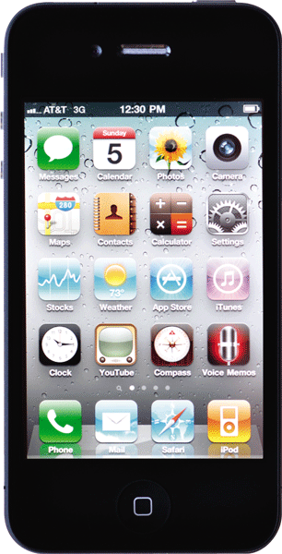
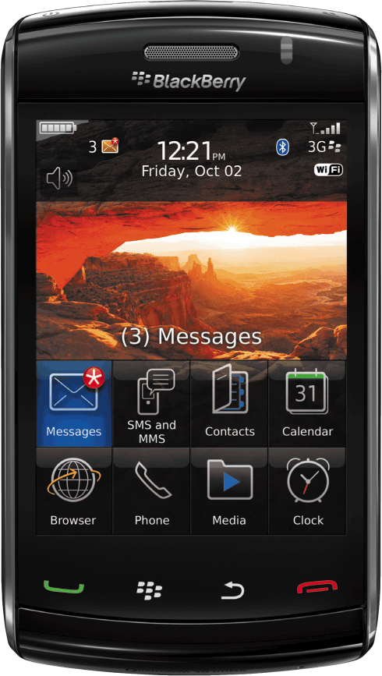
Embedded Operating Systems
Pages 419 – 420
Figures 8-22 – 8-26

Slide 35
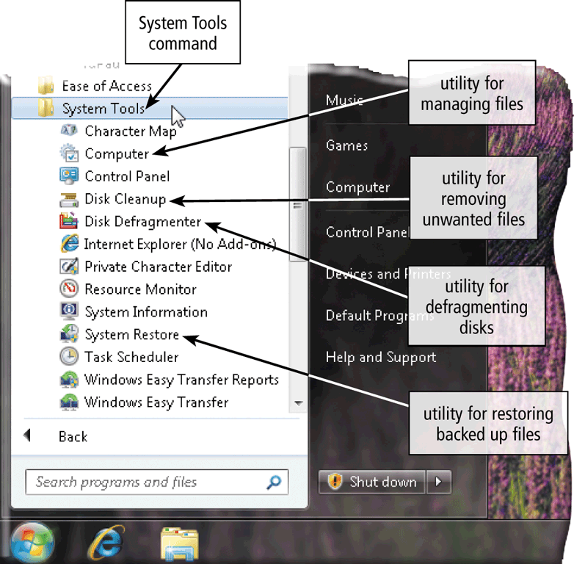
Utility Programs
A utility program is a type of system software that allows a user to perform maintenance-type tasks
Page 421
Figure 8-27

Slide 36
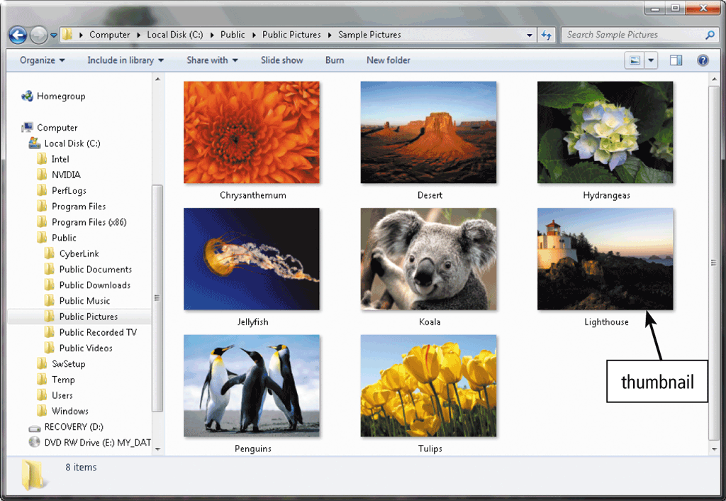
Utility Programs
A file manager is a utility that performs functions related to file management
Displaying a list of files
Organizing files in folders
Copying, renaming, deleting, moving, and sorting files and folders
Creating shortcuts
Page 422
Figure 8-28

Slide 37
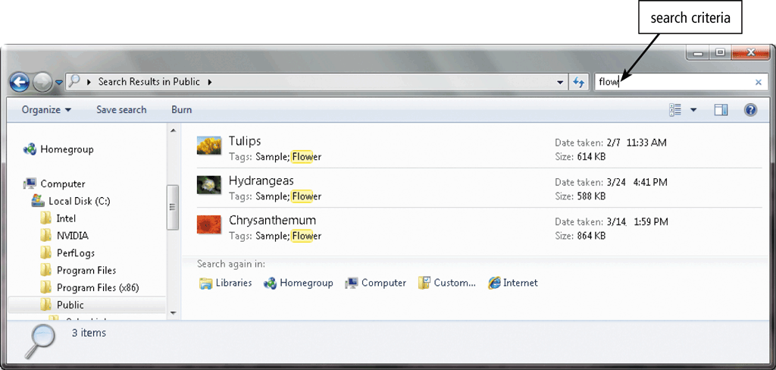
Utility Programs
A search utility is a program that attempts to locate a file on your computer based on criteria you specify
Page 422
Figure 8-29

Slide 38
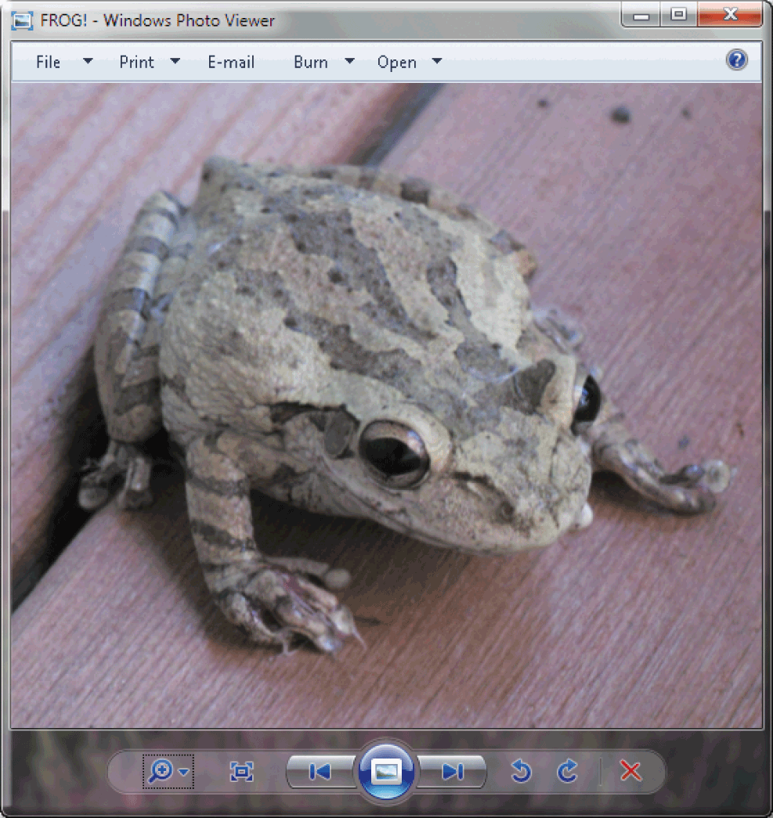
Utility Programs
An image viewer allows users to display, copy, and print the contents of a graphics file
An uninstaller removes a program, as well as any associated entries in the system files
Page 423
Figure 8-30

Slide 39
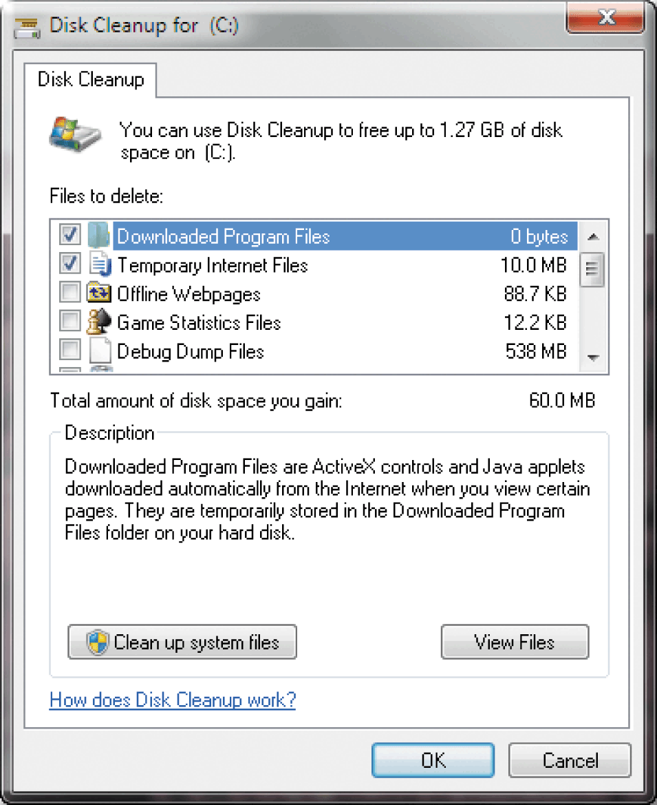
Utility Programs
A disk cleanup utility searches for and removes unnecessary files
Downloaded program files
Temporary Internet files
Deleted files
Unused program files
Page 423
Figure 8-31

Slide 40
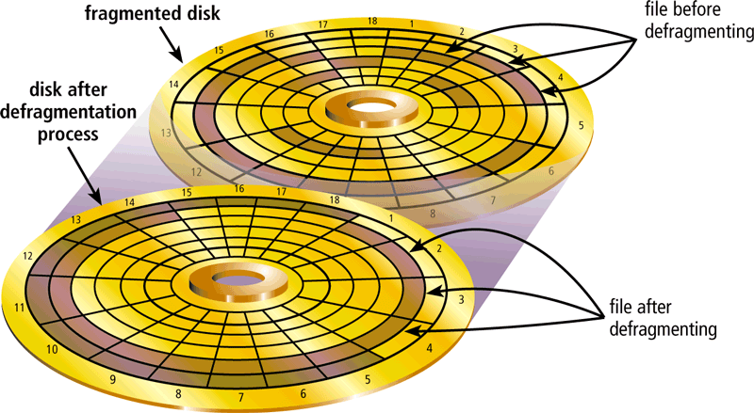
Utility Programs
A disk defragmenter reorganizes the files and unused space on a computer’s hard disk so that the operating system accesses data more quickly and programs run faster
Defragmenting
Pages 423 – 424
Figure 8-32

Slide 41
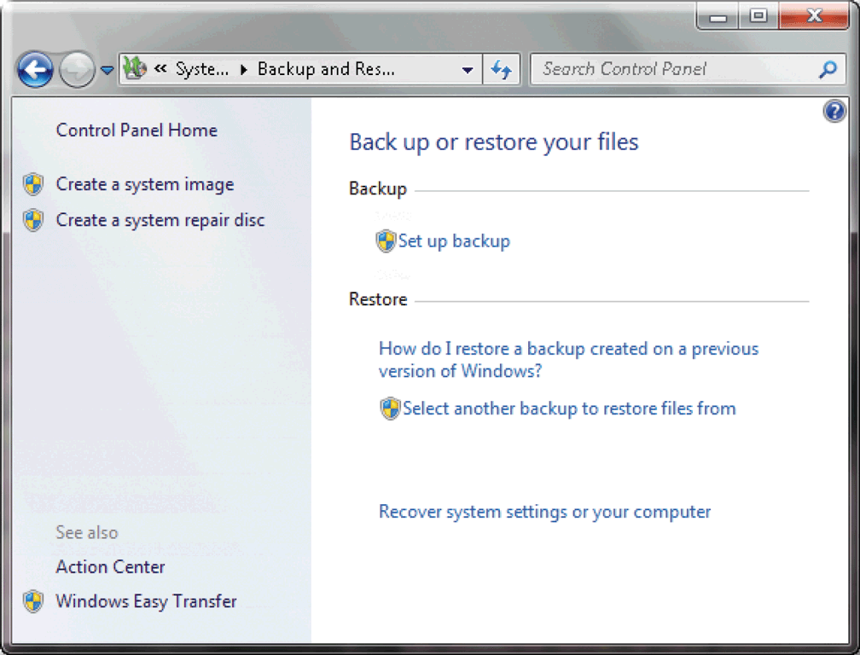
Utility Programs
A backup utility allows users to copy files to another storage medium
A restore utility reverses the process and returns backed up files to their original form
Page 424
Figure 8-33

Slide 42
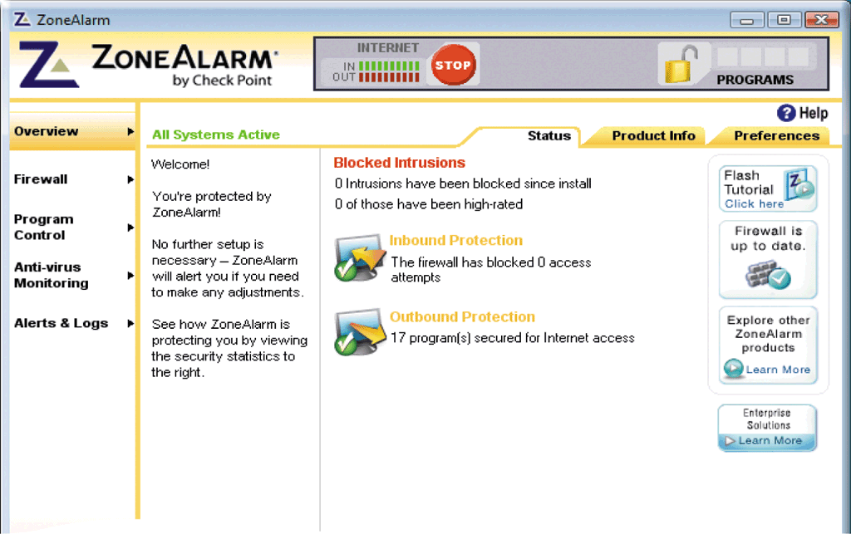
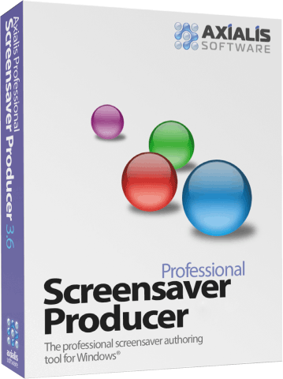
Utility Programs
A screen saver causes a display device’s screen to show a moving image or blank screen if no activity occurs for a specified time
A personal firewall detects and protects a personal computer from unauthorized intrusions
Page 425
Figures 8-34 – 8-35

Slide 43
Utility Programs
A virus describes a potentially damaging computer program that affects a computer negatively
A worm copies itself repeatedly in memory or over a network
A Trojan horse hides within or looks like a legitimate program
An antivirus program protects a computer against viruses
Pages 425 - 426

Slide 44
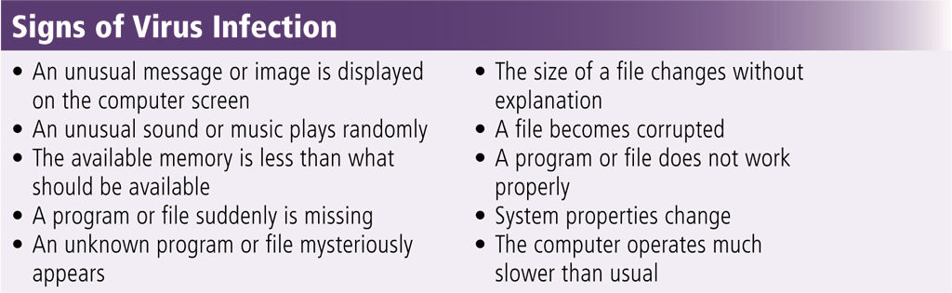
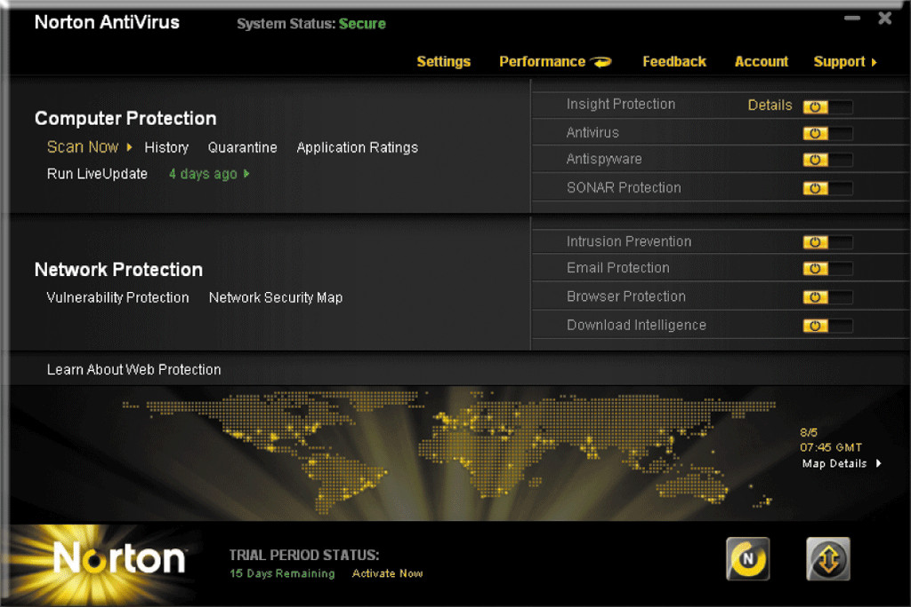
Utility Programs
Pages 425 – 426
Figures 8-36 – 8-37

Slide 45
Utility Programs
Spyware is a program placed on a computer without the user’s knowledge that secretly collects information about the user
Adware displays an online advertisement in a banner or pop-up window
A spyware remover detects and deletes spyware and other similar programs
An adware remover is a program that detects and deletes adware
Page 426

Slide 46
Utility Programs
Filters are programs that remove or block certain items from being displayed
Web filtering software
Anti-spam programs
Phishing filters
Pop-up blockers
Pages 426 - 427

Slide 47
Utility Programs
A file compression utility shrinks the size of a file(s)
Compressing files frees up room on the storage media
Two types of compression
Lossy
Lossless
Compressed files sometimes are called zipped files
Can be uncompressed
Page 427

Slide 48
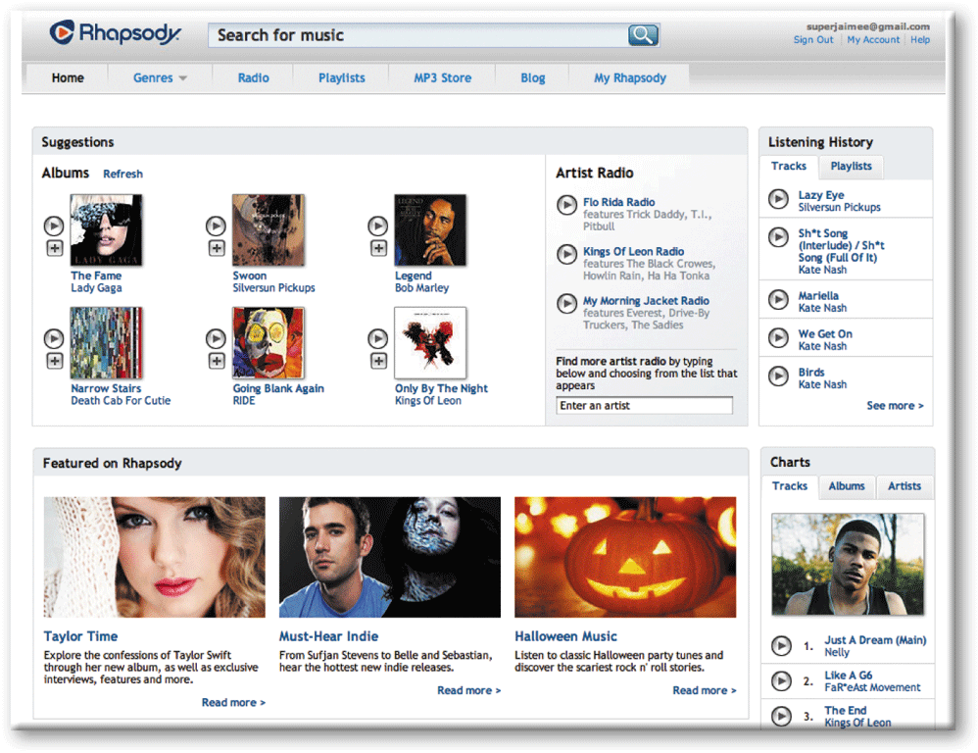
Utility Programs
A media player allows you to view images and animation, listen to audio, and watch video files on your computer
Page 427
Figure 8-38

Slide 49

Utility Programs
Disc burning software writes text, graphics, audio, and video files on a recordable or rewritable optical disc
Page 428
Figure 8-39

Slide 50

Utility Programs
A personal computer maintenance utility identifies and fixes operating system problems, detects and repairs disk problems, and includes the capability of improving a computer’s performance
Page 428
Figure 8-40

Slide 51
Summary
Definition of an operating system
Functions common to most operating systems
Variety of stand-alone operating systems, server operating systems, and embedded operating systems
Several utility programs
Page 429

Slide 52
Chapter 8 Complete

